Slide 1
Complexity of Insider Attacks to Databases
Gokhan Kul, Shambhu Upadhyaya, Andrew Hughes
Department of Computer Science and Engineering
University at Buffalo, SUNY
MIST '17 Proceedings of the 2017 International Workshop on Managing Insider Security Threats

Slide 2
Outline
Motivation & Goal
Intent Model
Threat Model
Harvester Attacker
Targeted Attacker
Adversarial Behavior
Conclusion
Future Work

Slide 3
Motivation & Goal
Insider attack is one of the most critical types of cyber attack.
34% from current employees, 29% from former employees.
Insider attack is the most costly attack type to an organization. 其中以金融機構受到insider attack的打擊最大。
Insider attack難以防治的困難點主要有三項:
發起攻擊的都是受信任的員工，且對於組織的內部資訊多有掌握，包含系統的安全架構以及資訊流。
Creating fine-grained and restrictive access policies for shared resources restrict a legitimate actor’s ability to adapt to new or unexpected tasks, while permissive policies allow room for exploitation.(Access policies兩難)
A new legitimate activity from a legitimate actor can be perceived as an anomaly although the intent is benign.(較難判斷到底發出指令的user意圖為何)
Notes:
Insider attack:員工誤用他們的合法權限，去得到未授權的資訊或資源，像是檔案系統或是資料庫。
Ex:開啟不被授權的帳號、金錢的轉移、個資盜取、信用詐欺等等。

Slide 4
Motivation & Goal
Current insider threat detection mechanisms usually depend on detecting anomalies in a user’s behavior, focusing on a specific type of resource, or a combination of resources.
These resources can be shell commands, file accesses, and SQL queries.
This paper analyzes insider threats against relational databases by focusing on the complexity aspects of most common threat models researched in the literature, along with the state of the art defense mechanisms to prevent them.
Literature survey lacks accurate modeling of insider threats in this domain, an analysis of computational complexity for user intent modeling, and a generalized strategy for dealing with such attacks.
Notes:
偵查內部攻擊者的機制主要關注在使用者的異常行為，比方說使用shell commands, File Access or SQL queries.

Slide 5
Motivation & Goal
本篇論文的團隊想要 bridge this gap by constructing the notion of user intent model, and creating a generalized threat model for database systems.
Defining the notion of intent model for database users.
Building a threat model for insider attacks in the context of relational databases.
Analyzing counter actions against the model threat.
Providing a computational complexity analysis for both the threat and defense mechanism.

Slide 6
Intent Model
Query feature extractions usually extract projections, selections, joins, group-by, and order-by items from the SQL query, or a subset of them, to be used in query similarity comparison.
Recording appearance frequency for each query in the dataset.
Then creating a feature vector using the frequency of these terms, which used to calculate the pairwise similarity of queries with cosine distance function.

Slide 7

Intent Model
Sometimes distinct queries produce the same set of features, and sometimes queries that aim to perform the same task can produce different sets of features.
(還有一種情況)The results of queries also depend on the data stored in the database. For example, the queries 會傳回相同的結果，假若資料庫裡存取的資料都是A開頭。
Source:this paper
Notes:
Hence, a query can be perceived with varying interpretations, which makes it
impossible to extract the definitive intent of the query writer
from a given query, but it is still possible to sense a fuzzy
notion of the a

Slide 8
Intent Model-Formal Context Analysis
Hence, a query can be perceived with varying interpretations, which makes it impossible to extract the definitive intent of the query writer from a given query, but it is still possible to sense a fuzzy notion of the aim.
Formal Context Analysis
A formal context is a triple K = G,M, I, where G is a set of objects, M is a set of attributes, and I is a relation that associates each object g with the attributes satisfied by g. In order to express that an object g is in relation I with an attribute m, it is written gIm.

Slide 9
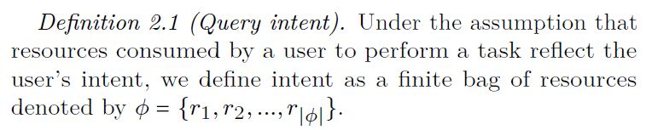
Intent Model-Formal Context Analysis
This team defines the attributes as the SQL query features. These attributes are essentially the resources consumed by the SQL query.
Source:this paper
Notes:
Identifying if a subset of attributes is a pseudo-intent is shown to be coNP-Complete [4].
It is also important to note that not all sets of attributes in a context represent a pseudointent; counting the number of pseudo-intents is proven to be #P-hard.
We will refer to these resources when we say query intent – (pseudo-intent in FCA domain), from now on.

Slide 10
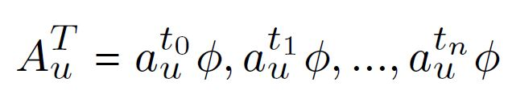
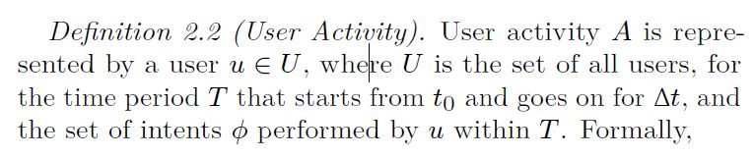

Intent Model-Formal Context Analysis
Source:this paper
Notes:
object g is in relation I with an attribute m, we write gIm [4].
The users usually create similar workloads on the database
to perform their daily tasks [22]. These workloads can be
utilized to create a chain of tasks for each user.

Slide 11
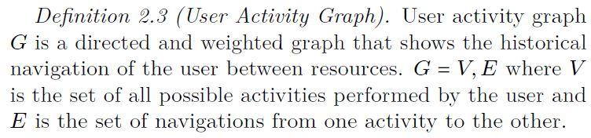
Intent Model-Formal Context Analysis
The users usually create similar workloads on the database to perform their daily tasks. These workloads can be utilized to create a chain of tasks for each user.
Notes:
There can be two types of weights:
(1) the number of different
items between two sets, and
(2) cumulative probability
of the next activity where the probability is calculated by
the division of the number of occurrences of an item to the
total item occurrences.

Slide 12
Threat Model
There are two type of security attacks as passive and active,
Passive: A passive attack attempts to learn or make use of information from the system but does not affect system resources.
Active: A active attack attempts to alter system resources or affect their operation.
In this paper, it do not address active attackers who tamper with the data, or query results because they aim to address the threat posed by insiders who try to steal information, in order to prevent identity theft, and information leakage.
Notes:
Both attack and defense strategies for this attack type are completely different.
If such an attack is successful, the adversary can access
the copy of the database instance offline without having to
go through the query monitor. To address data tampering
by an insider, the construction can be supported with integrity
verification techniques [19], and authenticated data
structures

Slide 13
Threat Model
There are two passive attack models:
Harvester (a.k.a.aggregate)
is an adversary who manages to replicate one part of the database for exploratory analysis by querying the database.
Targeted (a.k.a. individual) attackers
is an adversary who accesses certain information without needing to know for legitimate purposes, but chooses the attack parameters carefully to avoid being detected.
Notes:
Unlike an attacker who is trying to access information
from outside, an insider usually has knowledge about the
database and procedures within the organization. Using this
knowledge, they can exploit the privileges and trust placed
on them, and access information that they are not supposed
to see.

Slide 14
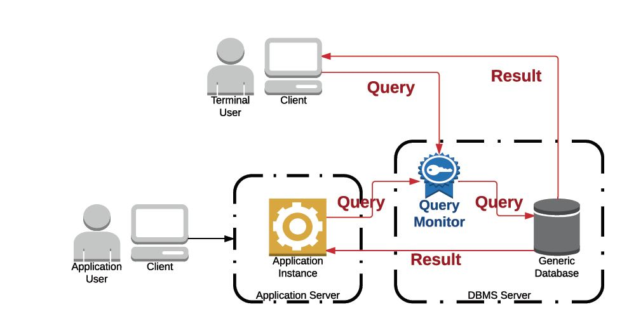
Threat Model
This team utilizes the query intent modeling while monitoring database activity to flag potential insider attacks. This construction aims to identify attackers to the database system.
Source:this paper
Notes:
The application users interact with the database using a web application on their computer (client-side). This application
generates queries, and issues them to the database, which is contained in a database server (server-side).
The terminal users interact with the database via a terminal interface on their computers, which directly connects them to the database
server.
The query monitor just observes the queries that are issued to the database, and it doesn’t block or change the
queries.
Any query that is issued to the database is captured by the query monitor, processed, logged, and then sent to the
database, respectively. It detects suspicious activity, and reports
them to the security personnel.
Consequently, the query monitor just observes the interaction between users and the database,
but never modifies the query results or database records.

Slide 15
Threat Model- Harvester Attacker
Harvester attacks focus on collecting a variety of information from the database, which result in search behaviors that show high levels of diversity and broadness.
Diversity is measured by the query and parameter similarity within a database session.
Broadness is measured by the variety of the return results from the queries within a database session.
Notes:
Assume that the adversaries within the organization have the domain knowledge
about the database schema, or have access to software tools that run on the database
without requiring the user to have familiarity to the underlying database, but they don’t
have any insight into the data content stored in the database

Slide 16
Threat Model- Harvester Attacker
When the attackers are not looking for specific information, they can issue exploratory queries on the system. This can be in two forms:
(1) None or few filtering conditions
(2) A lot of queries with filtering conditions.
Since this attack type does not have a specific target information, the adversary has only one goal: extracting as much information as possible.
In the most basic form, the adversary would issue wildcard queries for each table, and can retrieve all the database by issuing number of tables |R| queries.
Notes:
Assume that the adversaries within the organization have the domain knowledge
about the database schema, or have access to software tools that run on the database
without requiring the user to have familiarity to the underlying database, but they don’t
have any insight into the data content stored in the database

Slide 17
Threat Model- Harvester Attacker
Consider a database MY_BANK with relations:
CUSTOMER which includes details about the customers of a bank,
ACCOUNT which contains all the accounts the bank is handling, with many-to-many relationship,
CUSTOMER_ACCOUNTS which has the information of which accounts belong to which customers.
An insider who has information about MY_BANK schema can access all the data in the database with only 3 queries: SELECT * FROM customer, SELECT * FROM account, and SELECT * FROM customer accounts.

Slide 18
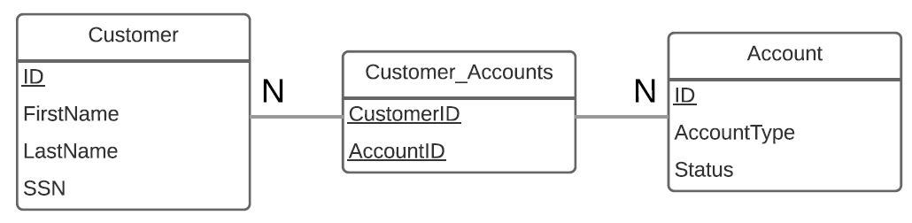
Threat Model- Harvester Attacker
MY_BANK Structure
It is also possible for the adversaries to utilize filtering conditions, which would result in increasing the number of queries, to avoid using wildcard queries to protect themselves from detection.
However, the query monitor, would log the resources accessed while evaluating the query and end up logging the same resources in both cases.
Hence, although there can be a lot of ways to harvest all the data, the complexity would still be O|R|.
Source:this paper

Slide 19
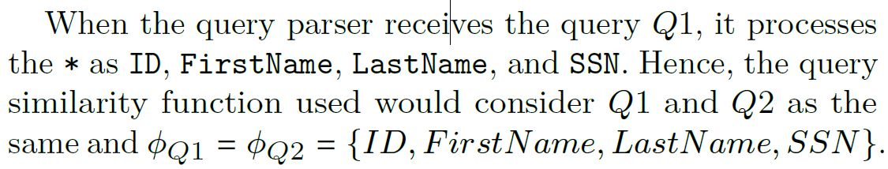
Threat Model- Harvester Attacker
MY_BANK Structure
For the logging mechanism, there is no difference between using wildcard queries, and using the resource names directly in the query.
For example:
Q1: SELECT *FROM customer
Q2: SELECT ID, FirstName, LastName, SSN FROM customer
Source:this paper
Notes:
See this ppt’s page 6 & 9.

Slide 20


Threat Model- Harvester Attacker
MY_BANK Structure
The complexity of feature extraction from the query can
be considered O1.
To create the intent for all ques in a user’s session, the system process all the queries in that session.
The time complexity to create the intent set is On, where n is the number of queries issued.
To compute the diversity, it compares the resources in with all the resources possible (S) in the database.
The time complexity of this operation is .
Source:this paper
Notes:
See this ppt’s page 6.

Slide 21
Threat Model- Targeted Attacker
Targeted attacks focus on specific information in the database, and investigate for sensitive information that the attacker is interested in.
The activities can be similar to the common, and legitimate activities of the user. However, the attacker acts without needing to know for any legitimate purposes.

Slide 22
Threat Model- Targeted Attacker
Knowing that issuing too many queries on a database could raise suspicions, a crafty insider should be precise about the information that they need. Thus, the retrieved rows should provide the maximum coverage, and minimum redundancy.
需要精準地使用Query的情況(原因):
The needed time to answer a query can dramatically increase as the complexity of the query increases.
The access policy can prevent certain information from being used together.
Accessing too much information can raise an alert.
Notes:
Still, the question remains if the resources that
the insider wants to access are in the database, and if they
can be retrieved with accessing a limited number of resources.

Slide 23
Threat Model- Targeted Attacker
Considering that the expressions included in the query reflect the intent of the attacker, use the intent model as a base while formulating the problem:
Question(INTENT SET PROBLEM):Every time a user issues a query, given a limitation of maximum number of resources that can be accessed, does there exist a query construction that will return the information that the user is looking for on the system?
Claim: The construction of the SQL query with the user’s intent is NP–Complete.
(詳細的證明在本篇論文第5頁左下欄)
Notes:
Still, the question remains if the resources that
the insider wants to access are in the database, and if they
can be retrieved with accessing a limited number of resources.

Slide 24
Threat Model- Targeted Attacker
Hence, given the relation between the user’s intent and the resources required for each intent, the problem to determine if a set of k resources provides access to the desired intent is NP-Complete.
Without having knowledge about the contents of the database, and having k number of constraints due to the risk of getting caught if too many resources are used, a query should be constructed very carefully by an attacker.
As the user intent grows, restricting k will make it more challenging to construct a query that provides access to the target data.

Slide 25
Threat Model- Targeted Attacker
The distinctive traits of targeted attacks are that the adversaries access information without needing to know, and deviate from their normal behavior. There are two approaches to prevent these attacks:
Misuse detection:
Focuses on detecting predetermined specific malicious activities. The defense mechanism creates rule sets on what kind of behavior a user should not perform which requires fine-grained security analysis on the system, and identifying what information each user should not have access to.

Slide 26
Threat Model- Targeted Attacker
Misuse detection mechanism is a rule based system, which checks every activity of a user to determine if it matches with the forbidden behavior defined in the rule set. This check is usually straight-forward, and takes linear time.
Anomaly detection focuses on deviations from normal patterns.
It forms user profiles in order to formulate a normal behavior pattern for each user.
The team takes every query issued by all users and extract the resources consumed to use them to create the user profiles.
After that, this problem can be approached as a clustering problem. The information collected is labeled with a clustering algorithm like k-means, or hierarchical clustering, while keeping the resource-user association.
Notes:
The team takes every query issued by all users and extract the resources consumed to use them to create the user profiles.
After that, this problem can be approached as a clustering problem. The information collected is labeled with a clustering algorithm like k-means, or hierarchical clustering, while keeping the resource-user association.

Slide 27
Threat Model- Targeted Attacker
A user profile can be created from the distribution of labels to each cluster.
Utilizing this information, the detection mechanism observes each query issued by each user, and catches the anomaly if a user’s distribution starts to shift from the profiled distribution.
Clustering based anomaly detection systems require a one time operation to create profiles. This operation can be repeated to update the user profiles as time progresses. The time complexity of the clustering operation depends on the selected technique;
A pairwise distance matrix, the operation has quadratic complexity
Heuristic based technique like k-means, the operation has linear complexity

Slide 28
Adversarial Behavior
An adversary launches an attack when they are convinced that the time and effort spent, and the risk taken to reach the information are worth the value of the information.
Assume that the adversary, being an insider, knows that there are security measures in place against insider attacks.
They can research on the defense strategies, and inquire about the system beforehand to find out the weaknesses in order to reduce the risk of getting caught.
However, while trying to reduce the risk, the adversary still needs to gain access to some key information to reach their target.

Slide 29
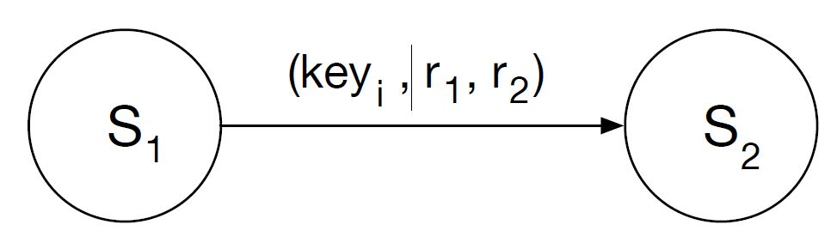
Adversarial Behavior
Key-Risk graph that shows different paths that an adversary can take to reach their target. It can be described every step in this path as follows:
State representing the adversary’s current status, S1
State representing the adversary’s desired status, S2
Key information needed to go from S1 to S2, keyi
Risk associated with the move if the adversary has keyi, r1
Risk associated with the move if the adversary does not have keyi, r2

Slide 30
Adversarial Behavior
Definition-Key Risk Graph:
Key Risk Graph KG is a directed graph that shows the adversary’s informational states, key information needed to change the current state to another, and risks associated with going one state to another.
Given a Key Risk Graph, the problem of finding an attack with the minimum risk is NP-Complete.(詳細的證明在論文第六頁)

Slide 31
Conclusion
In this paper, it first described the notion of user intent which can be utilized in insider threat detection research, discussed the complexity of identifying the intent of a user.
Defining two attack models:
(1) harvester attacks
(2) targeted attacks
Discussing the complexity of both attack, and defense mechanisms in the literature.
Discussing the key risk problem.

Slide 32
Future Work
Developing approximation algorithms for both intent detection, and targeted attack model.
Collecting query datasets to empirically show the efficacy of both harvester and targetd attack, and defense models defined in this work.
Analyzing the effect of approximation algorithms, and evaluating their real-world plausibility with the corresponding defense strategies.

